Slide 1

MINI PROJECT
GROUP MEMBERS | PRN
SHARLI RAKESH CHAUHAN | 123AX049
SARA AJAY BHALERAO | 123AX046
SRUSHTI RAMESH VETAL | 123AX058
SIDDHESH VENKAT | 123AX052

Slide 2

INTRODUCTION
Automated Plant Watering System
An automated plant watering system simplifies plant care by ensuring timely and accurate watering through soil moisture sensors. It prevents under or over-watering, making it ideal for busy individuals or large gardens. This system also conserves water, offering an eco-friendly approach to modern gardening with minimal human effort.

Slide 3

OBJECTIVE
Automate watering
Optimize water use
Improve plant health
Reduce labor
User interface
Automated Plant Watering System

Slide 4
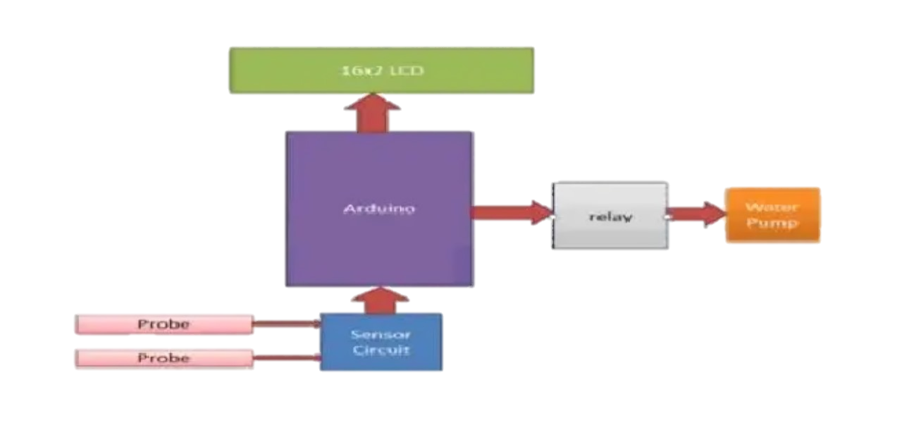
BLOCK DIAGRAM
ESP8266
Node MCU
Relay
Controller
Water
Pump
Probe
Moisture
sensor
Probe

Slide 5
BLOCK DIAGRAM
ESP8266
Node MCU
Relay
Controller
Water
Pump
Probe
Moisture
sensor
Probe

Slide 6
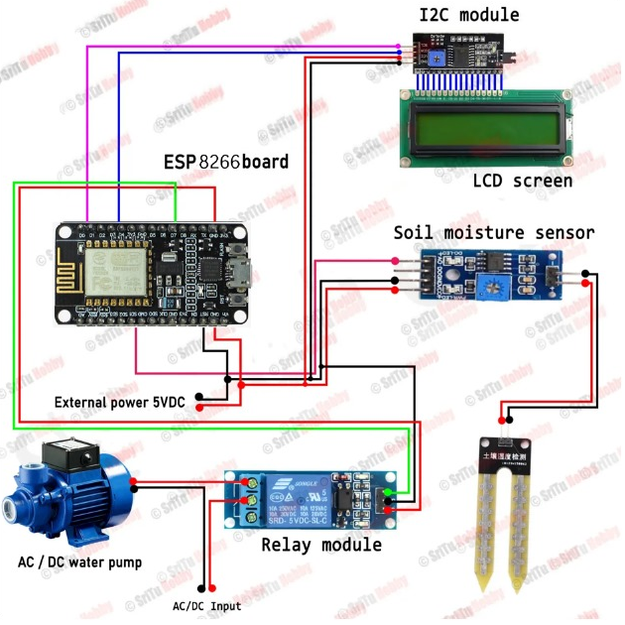
CIRCUIT DIAGRAM

Slide 7
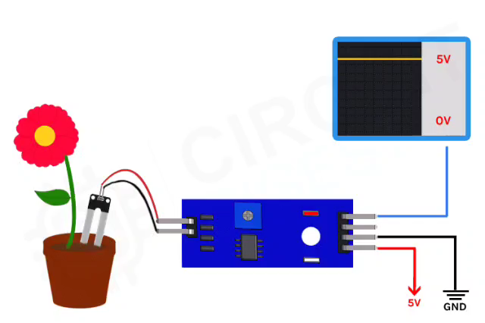
How Moisture sensor
works?🤔

Slide 8
METHODOLOGY
Define Requirements
Research and Plan: Investigate existing solutions and choose appropriate components (sensors, microcontroller…etc.).
Design: Create an architecture, decide sensor placement.
Test and Prototype: Build a prototype, write software for sensor data processing.
Validate: Conducting functional testing to ensure the system meets requirements.
Maintenance: Plan for ongoing maintenance.
There is always a room for Improvement!

Slide 9
Applications
Nursery and gardening.
Agricultural Field
Shopping complex

Slide 10
EXPENSE
Components | Price
Soil moisture sensor. | 114/-
Mini DC Motor Pump with Pipe | 119/-
Relay Module | 134/-
ESP 8266 Node MCU | 420/-
LCD & I2C Module | 320/-
Hw battery with clips | 158/-
Jumper wire | 50/-
 | Total-1315/ - (Approx)

Slide 11
Conclusion
This project designs an automatic plant irrigation system using Arduino, offering a more efficient and efficient method than manual irrigation.
The system can be operated from distant locations, reducing water waste and improving crop growth.
Future improvements include temperature sensors and a more powerful motor for larger-scale implementation.
This system is particularly useful in areas with limited water supply.

Slide 12


